Slide 1

Faking Keyboard/Mouse Input
Arduino Leonardo can appear as native keyboard and mouse to computer
Sends ascii characters to mimic keystrokes to your computer (only what you see on keyboard)
If you’re constantly mimic mouse and keyboard inputs, it will be very difficult to program your board again
I recommend using a button to toggle on and off this ability
Print to the serial monitor what you would do and check it first -> Serial.println() is your friend☺
Use the Keyboard and Mouse libraries

Slide 2
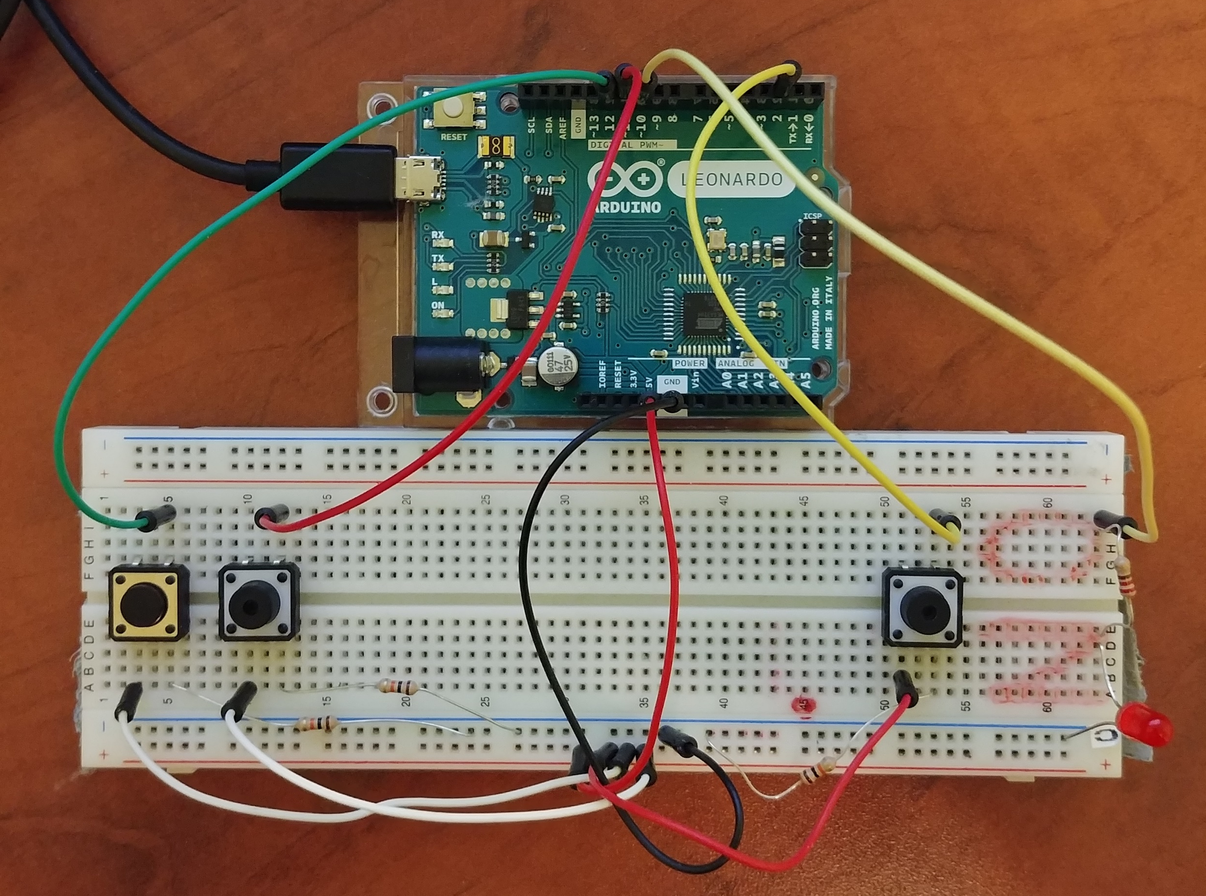
Example

Slide 3
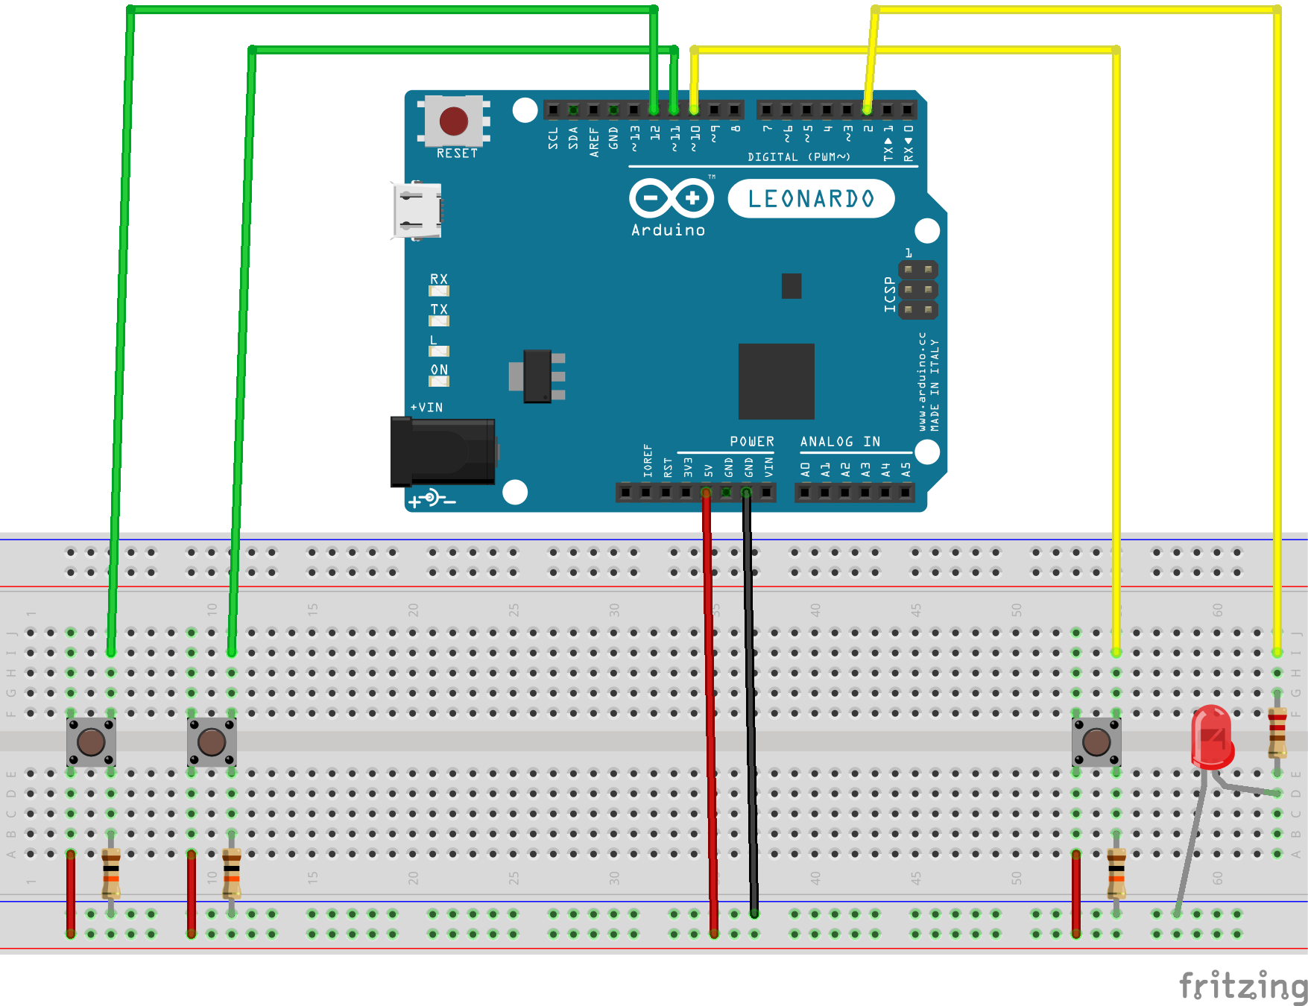
Example
Right Button
Left Button
220 Ω
Pull-Down Resistor (10 KΩ)

Slide 4
Example
https://github.com/GeoffSpielman/Hackathin_Examples
or search GitHub for ‘Hackathin_Examples’

Slide 5
Example
Important!

Slide 6
Example

Slide 7
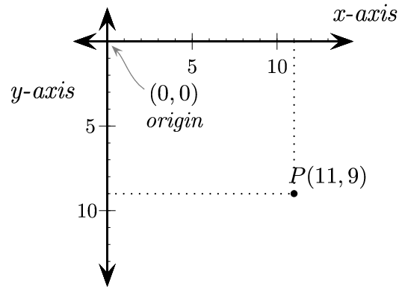
Example
Image: http://programarcadegames.com/chapters/05_intro_to_graphics/Computer_coordinates_2D.png

Slide 8
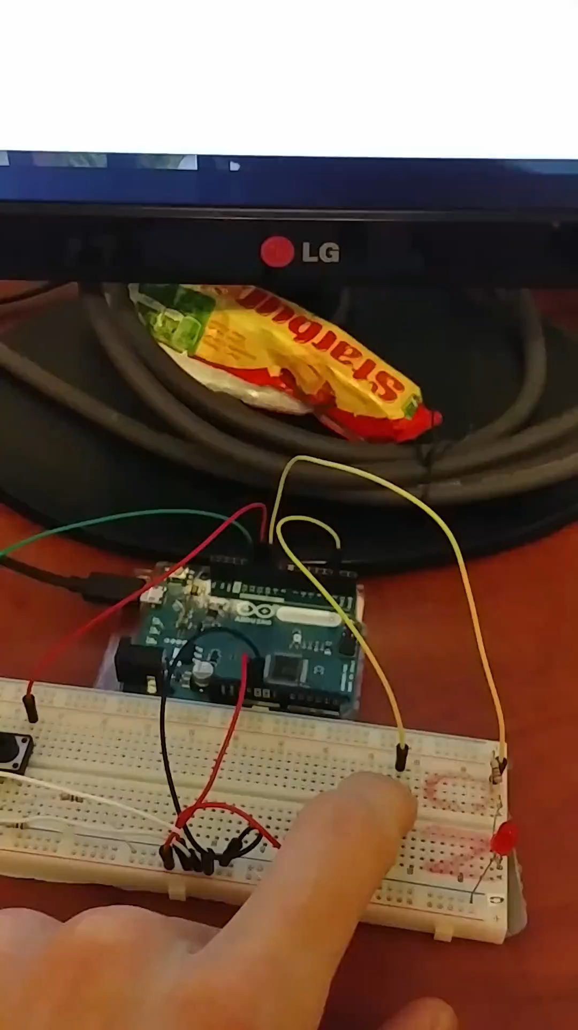

Slide 9
Side Note: Printing things in Setup()
Unlike the Uno, the Leonardo won't restart your sketch when you open a serial port on the computer
you won't see serial data that's already been sent to the computer (i.e. data sent in the setup() function)
Solution: wait until a serial connection is established before continuing with code
You will not get past this line unless the Arduino makes a serial connection
You MUST have the Serial Monitor open on your computer to move past this line
If you don’t, you won’t get into the main loop and nothing will work

